Slide 1
An Overview of CS512 @Spring 2017
Jiawei Han
Computer Science
University of Illinois at Urbana-Champaign
January 12, 2017

Slide 2
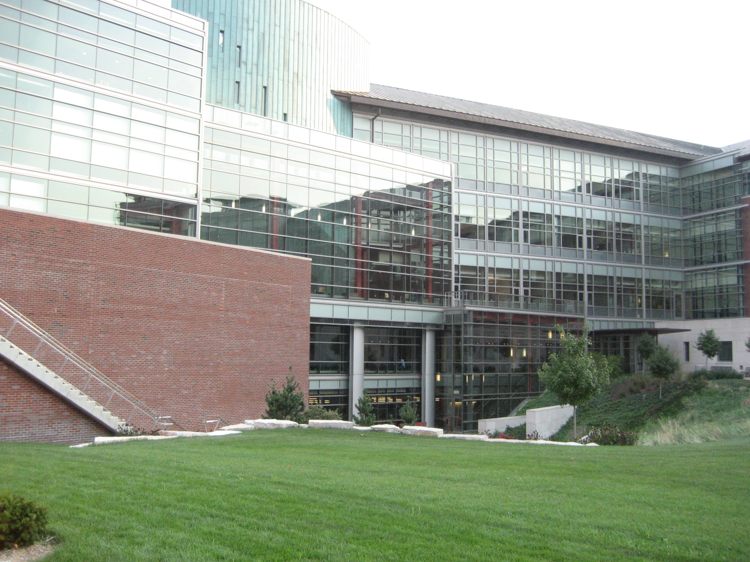

Slide 3
Data and Information Systems (DAIS) Course Structures at CS/UIUC
Three main streams: Database, data mining and text information systems
Seminar: Yahoo!-DAIS Seminar: (Not CS591 seminar, no credit given)
Database Systems:
Database management systems (CS411: Fall + Spring)
Advanced database systems (CS511: Fall)
Human-in-the-loop Data Management (CS 598: Aditya Parameswaran)
Data mining
Intro. to data mining (CS412: Fall + Spring)
Data mining: Principles and algorithms (CS512: Spring (Han))
Text information systems
Introduction to Text Information Systems (CS410: Spring (Zhai))
Advance Topics on Information Retrieval (CS 598 or CS510: Fall (Zhai))
Social & Economic Networks (CS 598: Hari Sundaram)

Slide 4
Coursera Data Mining Specialization
Coursera Data Mining Specialization
Data Visualization: John Hart
Pattern Discovery in Data Mining: Jiawei Han
Text Retrieval and Search Engines: ChengXiang Zhai
Cluster Analysis in Data Mining: Jiawei Han
Text Mining and Analytics: ChengXiang Zhai
Data Integration and Data Warehousing: Kevin Chang
Capstone Data Mining Capstone (6 weeks)
Online MCS Data Science Master program (https://online.illinois.edu/mcs-ds)

Slide 5
Another Related Course: CS 598 tar: Social Sensing
CS 598 tar: Social Sensing (Tarek Abdelzaher) Wed/Fri: 12:30-1:45pm
An important emerging category of cyber-physical systems are those that function in social spaces. These systems are ushered in by the proliferation of "sensing" devices (e.g., phones, wearables, and "smart home" technologies) in the possession of the average individual, as well as our ubiquitous mobile connectivity and the rise of social media (e.g., Twitter and Instagram).
New data fusion systems are envisioned that will use social networks as sensor networks, and will integrate inputs from IoT devices, physicals sensors, mobile phones, and social media to develop myriads of new services and applications for future smart cities and connected communities.
This paper-reading course covers the unfolding research challenges and directions in distributed social sensing, and overviews the broader landscape of cyber-physical systems, discusses common misconceptions, presents the underlying theoretical foundations, and sheds light on related recent technologies and publications.
The course includes a group project (in groups of 2 or 3) that will utilize one or more of the social sensing technologies (e.g., sensors, smart-phones, or APIs to social media such as Twitter and Instagram) to build novel applications or services. In the past, many projects resulted in publications. Budget will be available for individual projects to buy devices needed, if not already on hand.

Slide 6

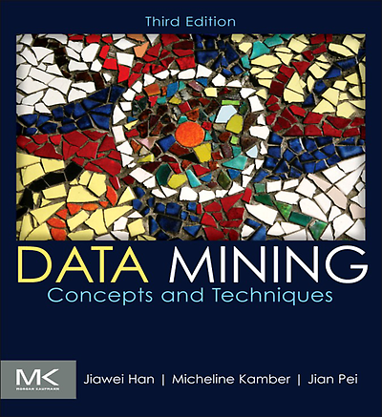
Topic Coverage: CS512 @ 2017
Class introduction (0.5 wk)
An overview on recent data mining research (0.5 wk)
Introduction to networks (1.5 weeks)
Mining heterogeneous information networks (3 weeks)
1st midterm exam (0.5week) — 1st Lect. of 7th week
Text mining (3 weeks)
Truth finding (1 week)
Spring break (1 week)
Mining social media and spatiotemporal data (1 week)
Stream data mining (1 week) if time permits
Selected class survey presentation (1 week)
2nd midterm exams (0.5 week) —2nd Lect. of 15th week
Class research project presentation (final week + exam week)

Slide 7
Class Information
Instructor: Jiawei Han (www.cs.uiuc.edu/~hanj)
Lectures: Tues/Thurs 9:30-10:45am (0216 SC) Office hours: Tues/Thurs 10:45-11:30am (2132 SC)
Teach Assistants:
Shi Zhi (shizhi2), Xiang Ren (xren7), Wenqi He, Dongming Lei
Prerequisites (course preparation)
CS412 (offered every semester) or consent of instructor
General background: Knowledge on statistics, machine learning, and data and information systems will help understand the course materials
Course website (bookmark it since it will be used frequently!)
https://wiki.cites.illinois.edu/wiki/display/cs512/Lectures
Textbook:
L. Barabasi, Network Science, Cambridge Press 2016. http://barabasi.com/networksciencebook
Yizhou Sun and Jiawei Han, Mining Heterogeneous Information Networks: Principles and Methodologies, Morgan & Claypool, 2012
J. Han, M. Kamber, J. Pei, Data Mining: Concepts and Techniques, 3rd ed., Morgan Kaufmann, 2011
A set of recent published research papers (see course syllabus)

Slide 8
Textbook & Recommended Reference Books
Textbook
Yizhou Sun and Jiawei Han, Mining Heterogeneous Information Networks: Principles and Methodologies, Morgan & Claypool, 2012
Jiawei Han, Micheline Kamber, Jian Pei, Data Mining: Concepts and Techniques, 3rd ed., Morgan Kaufmann, 2011
Recommended reference books
Mark Newman, Networks: An Introduction, Oxford Univ. Press, 2010
Albert-László Barabási, Network Science, Cambridge Univ. Press, Aug. 2016
M. J. Zaki and W. Meira, Jr. “Data Mining and Analysis: Fundamental Concepts and Algorithms”, Cambridge University Press, 2014
K. P. Murphy, "Machine Learning: a Probabilistic Perspective", MIT Press, 2012
Reference papers
A list of reference papers will be made available at course “resource” page

Slide 9
Course Work: Assignments, Exams and Course Project
Assignments: (2 assignments) 10% total
Two midterm exams: (20% each) 40% in total
Research project proposal (one-page): 0% (due at the end of 4th week)
Class attendance (3%): Max misses w/o penalty: 3, then −0.3% for each miss
Class presentation and/or research survey (12% total)
Survey report [expect to be comprehensive and in high quality, ≈ 20 pages]
Encourage to align with your research project topic domain
Report plus companion presentation slides [due at the end of 12th week]
Class presentation: May use 10 min. class survey presentation to replace the survey report (consent of instructor)—contents must closely aligned with the class content and in very high technical quality
Final course project: 35% (due at the end of semester)
Evaluated by class (50%) and TA + instructor (50%) collectively!

Slide 10
Research Projects Evaluation
Final course project: 35% (due at the end of semester)
The final project will be evaluated based on (1) technical innovation, (2) thoroughness of the work, and (3) clarity of presentation
The final project will need to hand in: (1) project report (length will be similar to a typical 8-12 page double-column conference paper), and (2) project presentation slides (which is required for both online and on-campus students)
Each course project for every on-campus student will be evaluated collectively by instructor (plus TA) and other on-campus students in the same class
The course project for online students will be evaluated by instructors and TA only
Group projects (both survey and research): Single-person project is OK, also encouraged to have two as a group, and team up with other senior graduate students, and will be judged by them

Slide 11
Where to Find Reference Papers?
Course research papers: Check reading list and list of papers at the end of each set of chapter slides
Major conference proceedings that will be used
DM conferences: ACM SIGKDD (KDD), ICDM (IEEE, Int. Conf. Data Mining), SDM (SIAM Data Mining), ECMLPKDD (Principles KDD), PAKDD (Pacific-Asia)
DB conferences: ACM SIGMOD, VLDB, ICDE
ML conferences: NIPS, ICML
IR and Web conferences: SIGIR, CIKM, WWW, WSDM
Social network confs: ASONAM
Other related conferences and journals
IEEE TKDE, ACM TKDD, DMKD, ML
Use course Web page, DBLP, Google Scholar, Citeseer

Slide 12

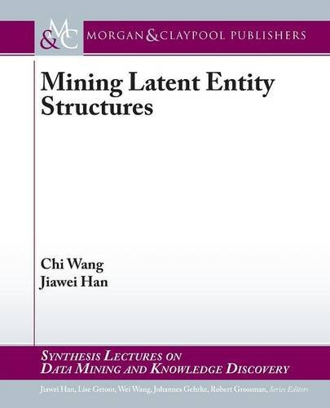
From Data to Networks to Knowledge: An Evolutionary Path!
Han, Kamber and Pei,
Data Mining, 3rd ed. 2011
Yu, Han and Faloutsos (eds.),
Link Mining: Models, Algorithms and Applications, 2010
Sun and Han, Mining Heterogeneous
Information Networks, 2012
Y. Sun: SIGKDD’13 Dissertation Award
Wang and Han, Mining Latent Entity Structures, 2015
C. Wang: SIGKDD’15 Dissertation Award

Slide 13


